Slide 1


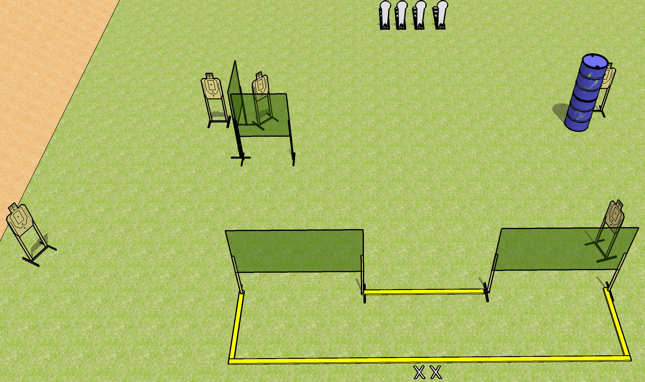
 | Dothan Gun Club – USPSA Match Yawn Course Designer : Drew Coleman
Round Count 14 rounds 5 USPSA 4 Colt poppers
Equipment List 7 wall feet 2 medium fault lines

Slide 2
Yawn
Written Stage Briefing
Yawn is a 14 round, 70 point, Comstock course of fire. There are 5 USPSA targets and 4 Colt poppers. The best 2 hits on paper will score, and steel must fall to score. The start sigal is audible.
Handgun start position is feet on X’s, wrists below belt. Handgun is loaded and holstered.
PCC start position is feet on X’s, stock on belt. Carbine is loaded with safety on.
On start signal, engage targets as they become available from within the shooting area.\

